Slide 1
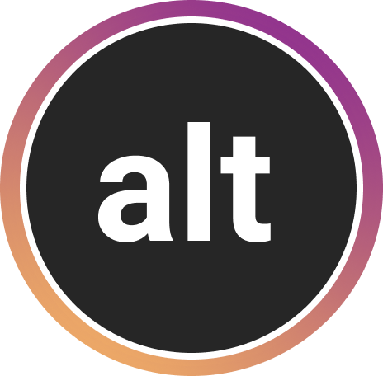
ALTogether
Danielle, Jung-Won, Haeli, Sydney
Notes:
Overview

Slide 2
Value Prop, Problem and Solution
Tasks
Revised Interface Design
Prototype Overview
Appendix

Slide 3
Value Prop, Problem & Solution
Notes:
Sydney

Slide 4
ALTogether
Value Proposition
Creating richer, more reliable alt text
Mission Statement
Our goal is to increase overall awareness about accessibility needs for the visually-impaired by guiding individuals to share accessible content on Instagram.
Notes:
Considered chrome extensions, a separate app, general extension that worked across all social media
If we really wanted to innovate new interactions that were unique and engaging, we would have to tailor it to a specific user flow
So getting into the nitty gritty details would allow us to make interactions that were natural, integrated, and not too heavy of a “lift” for the user
It also plays into our value of normalization - visually imapired interviewees wanted to use the same technologies everyone else does, and most people don’t want to download a new app or change the way they interact with their platforms
Few ways this would work, ideally, we could partner with instagram
Extension that users could download that would make a few changes to their instagram app
We wanted to make sure it worked for mobile since most social media is accessed mobilly, and we chose instagram because the primary way of interfacing with this platform is through pictures
We thought it would be a perfect candidate for our idea.
From Jung-Won’s pros and cons list!
Rationale for Mobile Extension > Camera Extension:
Integrating the extension directly into Instagram reduces the need to switch back and forth between different apps in order to write alt text for images
Auto-generated alt text captions are often very inconsistent and unreliable
We chose Instagram over other social media platforms because it is purely image-based, so it is the least accessible without alt text.
People are less likely to take pictures with a separate camera app. Instead, people are more likely to write an alt text for an image they have already taken at the time of uploading.

Slide 5
ALTogether
Problem and Solution Overview
Blind and visually impaired users often feel frustrated with the lack of focus, context, and emotion in auto-generated alt text on Instagram. ALTogether promotes richer and more reliable alt text by providing sighted users a scaffolded way to personally write quality alt text by modifying AI-generated suggestions on their images before posting. ALTogether not only encourages sighted users to adopt alt text practices, but also motivates followers to do the same through social incentives.
Notes:
Considered chrome extensions, a separate app, general extension that worked across all social media
If we really wanted to innovate new interactions that were unique and engaging, we would have to tailor it to a specific user flow
So getting into the nitty gritty details would allow us to make interactions that were natural, integrated, and not too heavy of a “lift” for the user
It also plays into our value of normalization - visually imapired interviewees wanted to use the same technologies everyone else does, and most people don’t want to download a new app or change the way they interact with their platforms
Few ways this would work, ideally, we could partner with instagram
Extension that users could download that would make a few changes to their instagram app
We wanted to make sure it worked for mobile since most social media is accessed mobilly, and we chose instagram because the primary way of interfacing with this platform is through pictures
We thought it would be a perfect candidate for our idea.
From Jung-Won’s pros and cons list!
Rationale for Mobile Extension > Camera Extension:
Integrating the extension directly into Instagram reduces the need to switch back and forth between different apps in order to write alt text for images
Auto-generated alt text captions are often very inconsistent and unreliable
We chose Instagram over other social media platforms because it is purely image-based, so it is the least accessible without alt text.
People are less likely to take pictures with a separate camera app. Instead, people are more likely to write an alt text for an image they have already taken at the time of uploading.

Slide 6
Tasks
Notes:
Sydney

Slide 7
Tasks
Simple
Sighted users are reminded to write alt text and can lfindl where to write it in the first place
Notes:
Considered chrome extensions, a separate app, general extension that worked across all social media
If we really wanted to innovate new interactions that were unique and engaging, we would have to tailor it to a specific user flow
So getting into the nitty gritty details would allow us to make interactions that were natural, integrated, and not too heavy of a “lift” for the user
It also plays into our value of normalization - visually imapired interviewees wanted to use the same technologies everyone else does, and most people don’t want to download a new app or change the way they interact with their platforms
Few ways this would work, ideally, we could partner with instagram
Extension that users could download that would make a few changes to their instagram app
We wanted to make sure it worked for mobile since most social media is accessed mobilly, and we chose instagram because the primary way of interfacing with this platform is through pictures
We thought it would be a perfect candidate for our idea.
From Jung-Won’s pros and cons list!
Rationale for Mobile Extension > Camera Extension:
Integrating the extension directly into Instagram reduces the need to switch back and forth between different apps in order to write alt text for images
Auto-generated alt text captions are often very inconsistent and unreliable
We chose Instagram over other social media platforms because it is purely image-based, so it is the least accessible without alt text.
People are less likely to take pictures with a separate camera app. Instead, people are more likely to write an alt text for an image they have already taken at the time of uploading.

Slide 8
Tasks
Moderate
Sighted users lidentifyl which photos lack alt text and lencouragel friends to add their own alt texts

Slide 9
Tasks
Complex
Sighted users lmodifyl auto-generated alt text suggestions to add personalized lcontextl to their images
Notes:
Considered chrome extensions, a separate app, general extension that worked across all social media
If we really wanted to innovate new interactions that were unique and engaging, we would have to tailor it to a specific user flow
So getting into the nitty gritty details would allow us to make interactions that were natural, integrated, and not too heavy of a “lift” for the user
It also plays into our value of normalization - visually imapired interviewees wanted to use the same technologies everyone else does, and most people don’t want to download a new app or change the way they interact with their platforms
Few ways this would work, ideally, we could partner with instagram
Extension that users could download that would make a few changes to their instagram app
We wanted to make sure it worked for mobile since most social media is accessed mobilly, and we chose instagram because the primary way of interfacing with this platform is through pictures
We thought it would be a perfect candidate for our idea.
From Jung-Won’s pros and cons list!
Rationale for Mobile Extension > Camera Extension:
Integrating the extension directly into Instagram reduces the need to switch back and forth between different apps in order to write alt text for images
Auto-generated alt text captions are often very inconsistent and unreliable
We chose Instagram over other social media platforms because it is purely image-based, so it is the least accessible without alt text.
People are less likely to take pictures with a separate camera app. Instead, people are more likely to write an alt text for an image they have already taken at the time of uploading.

Slide 10
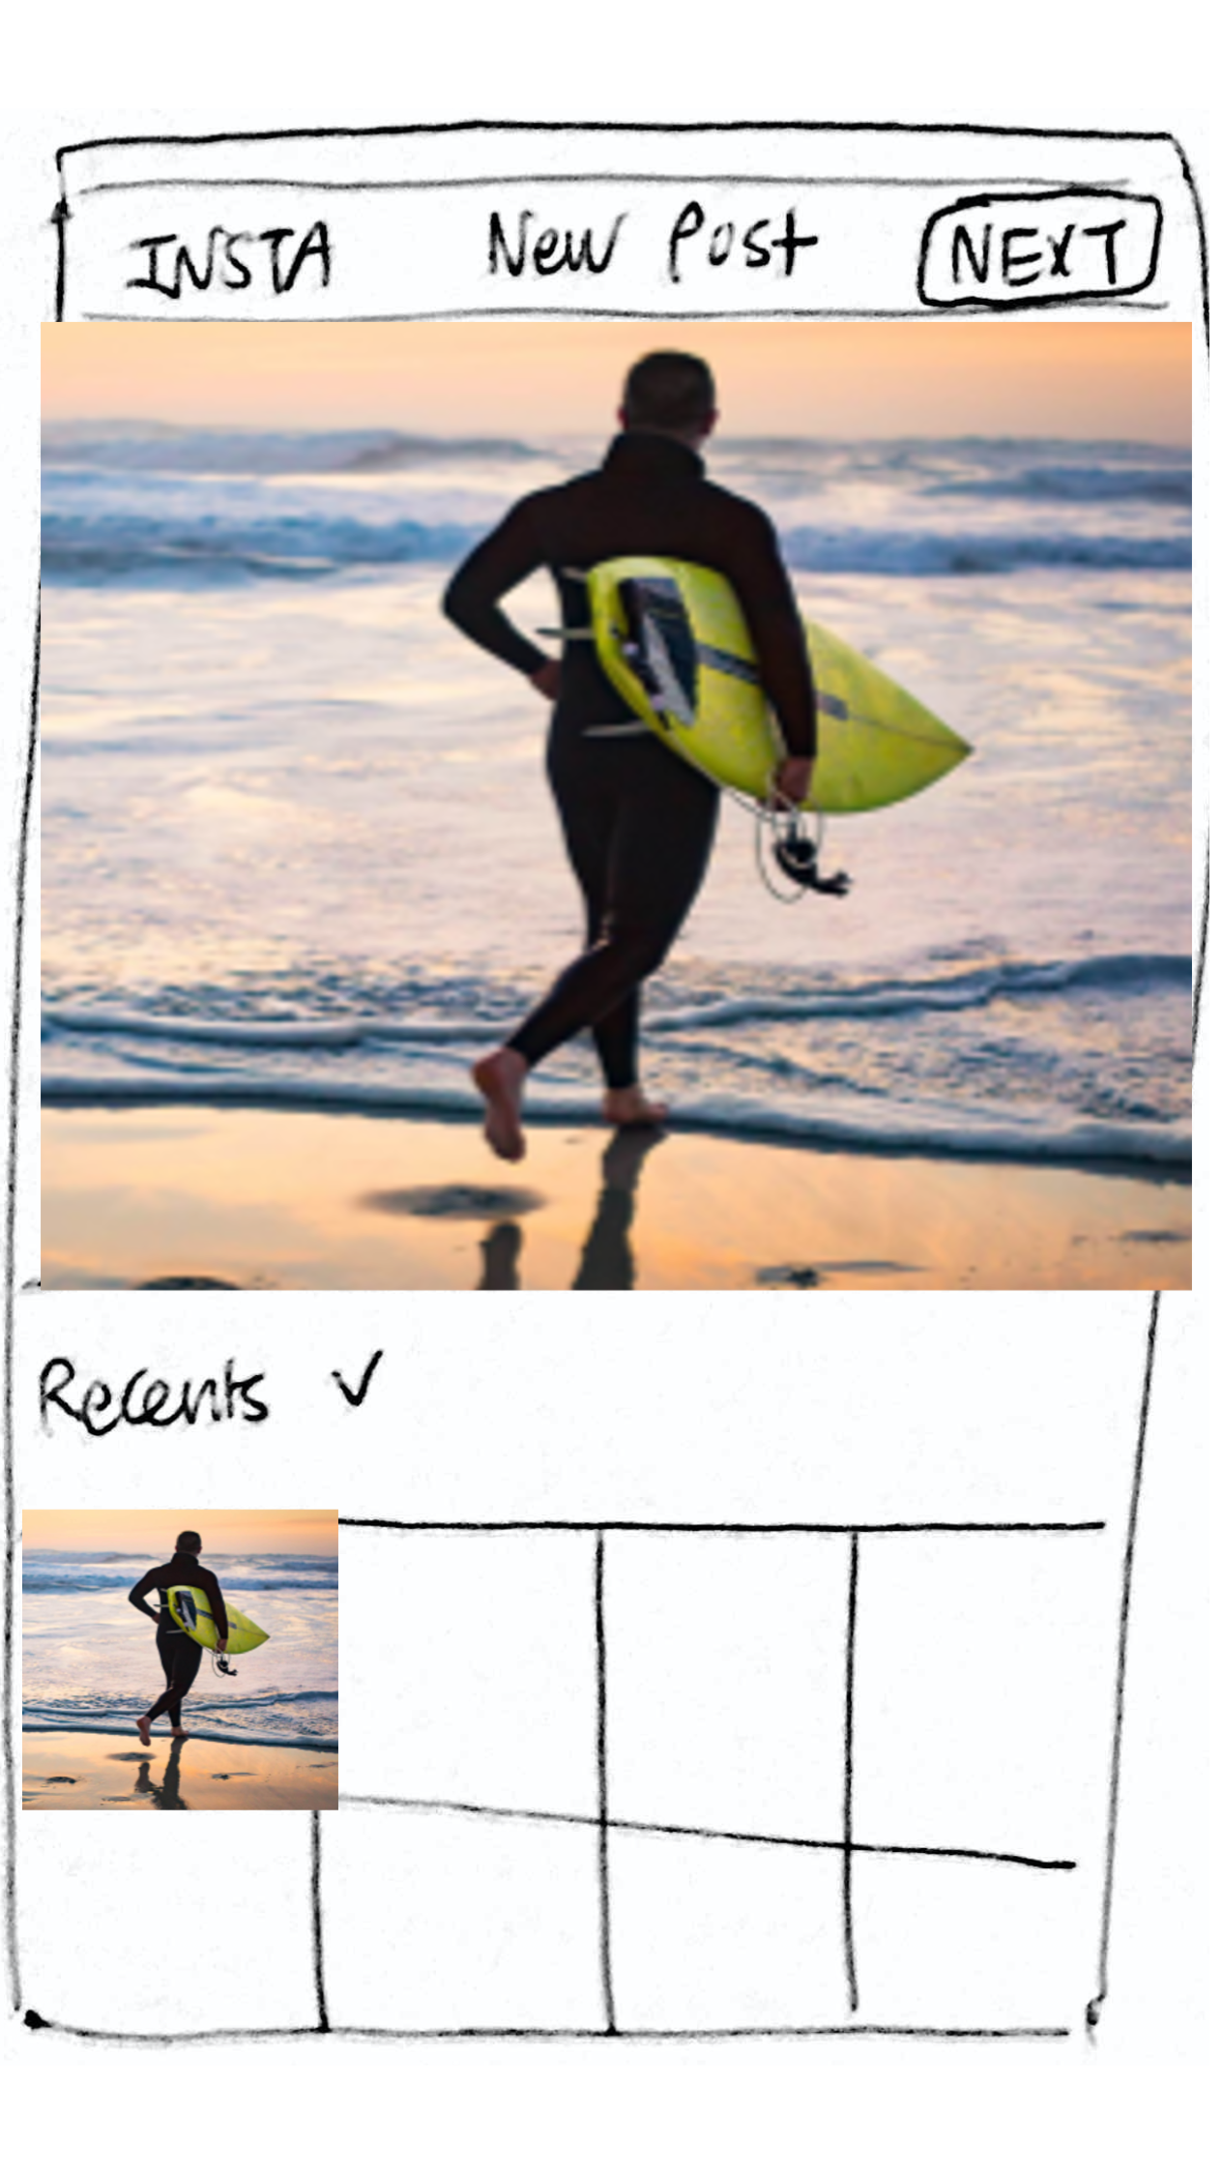
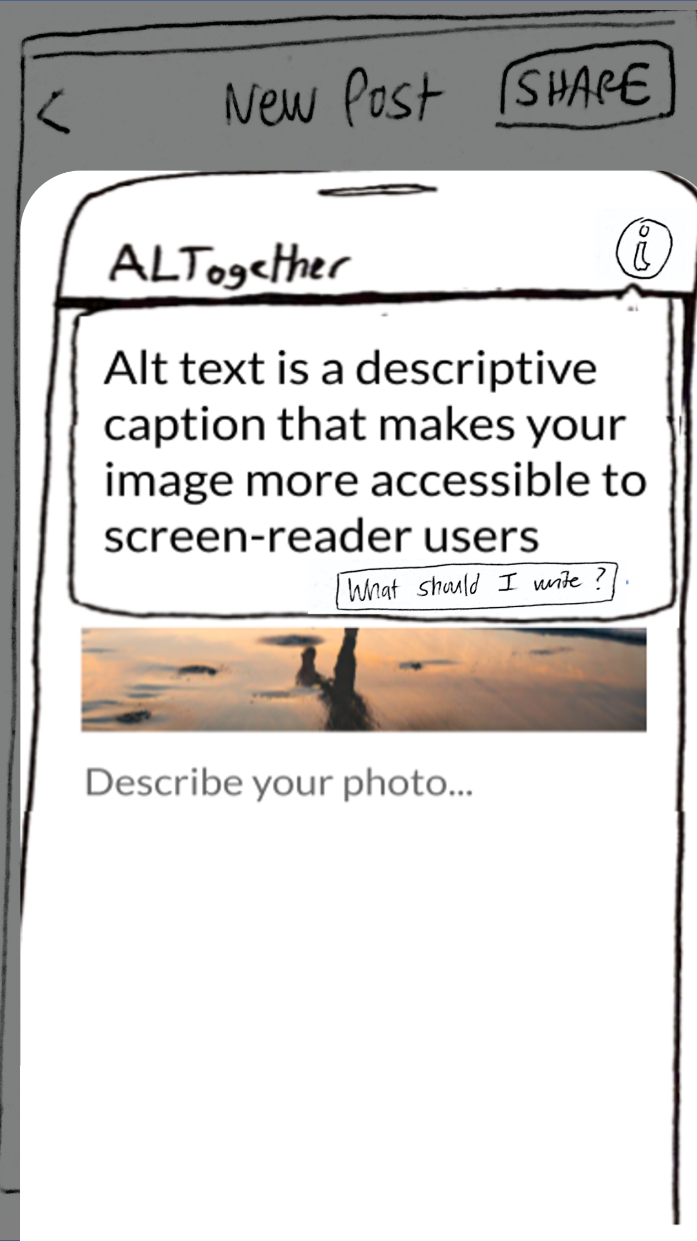
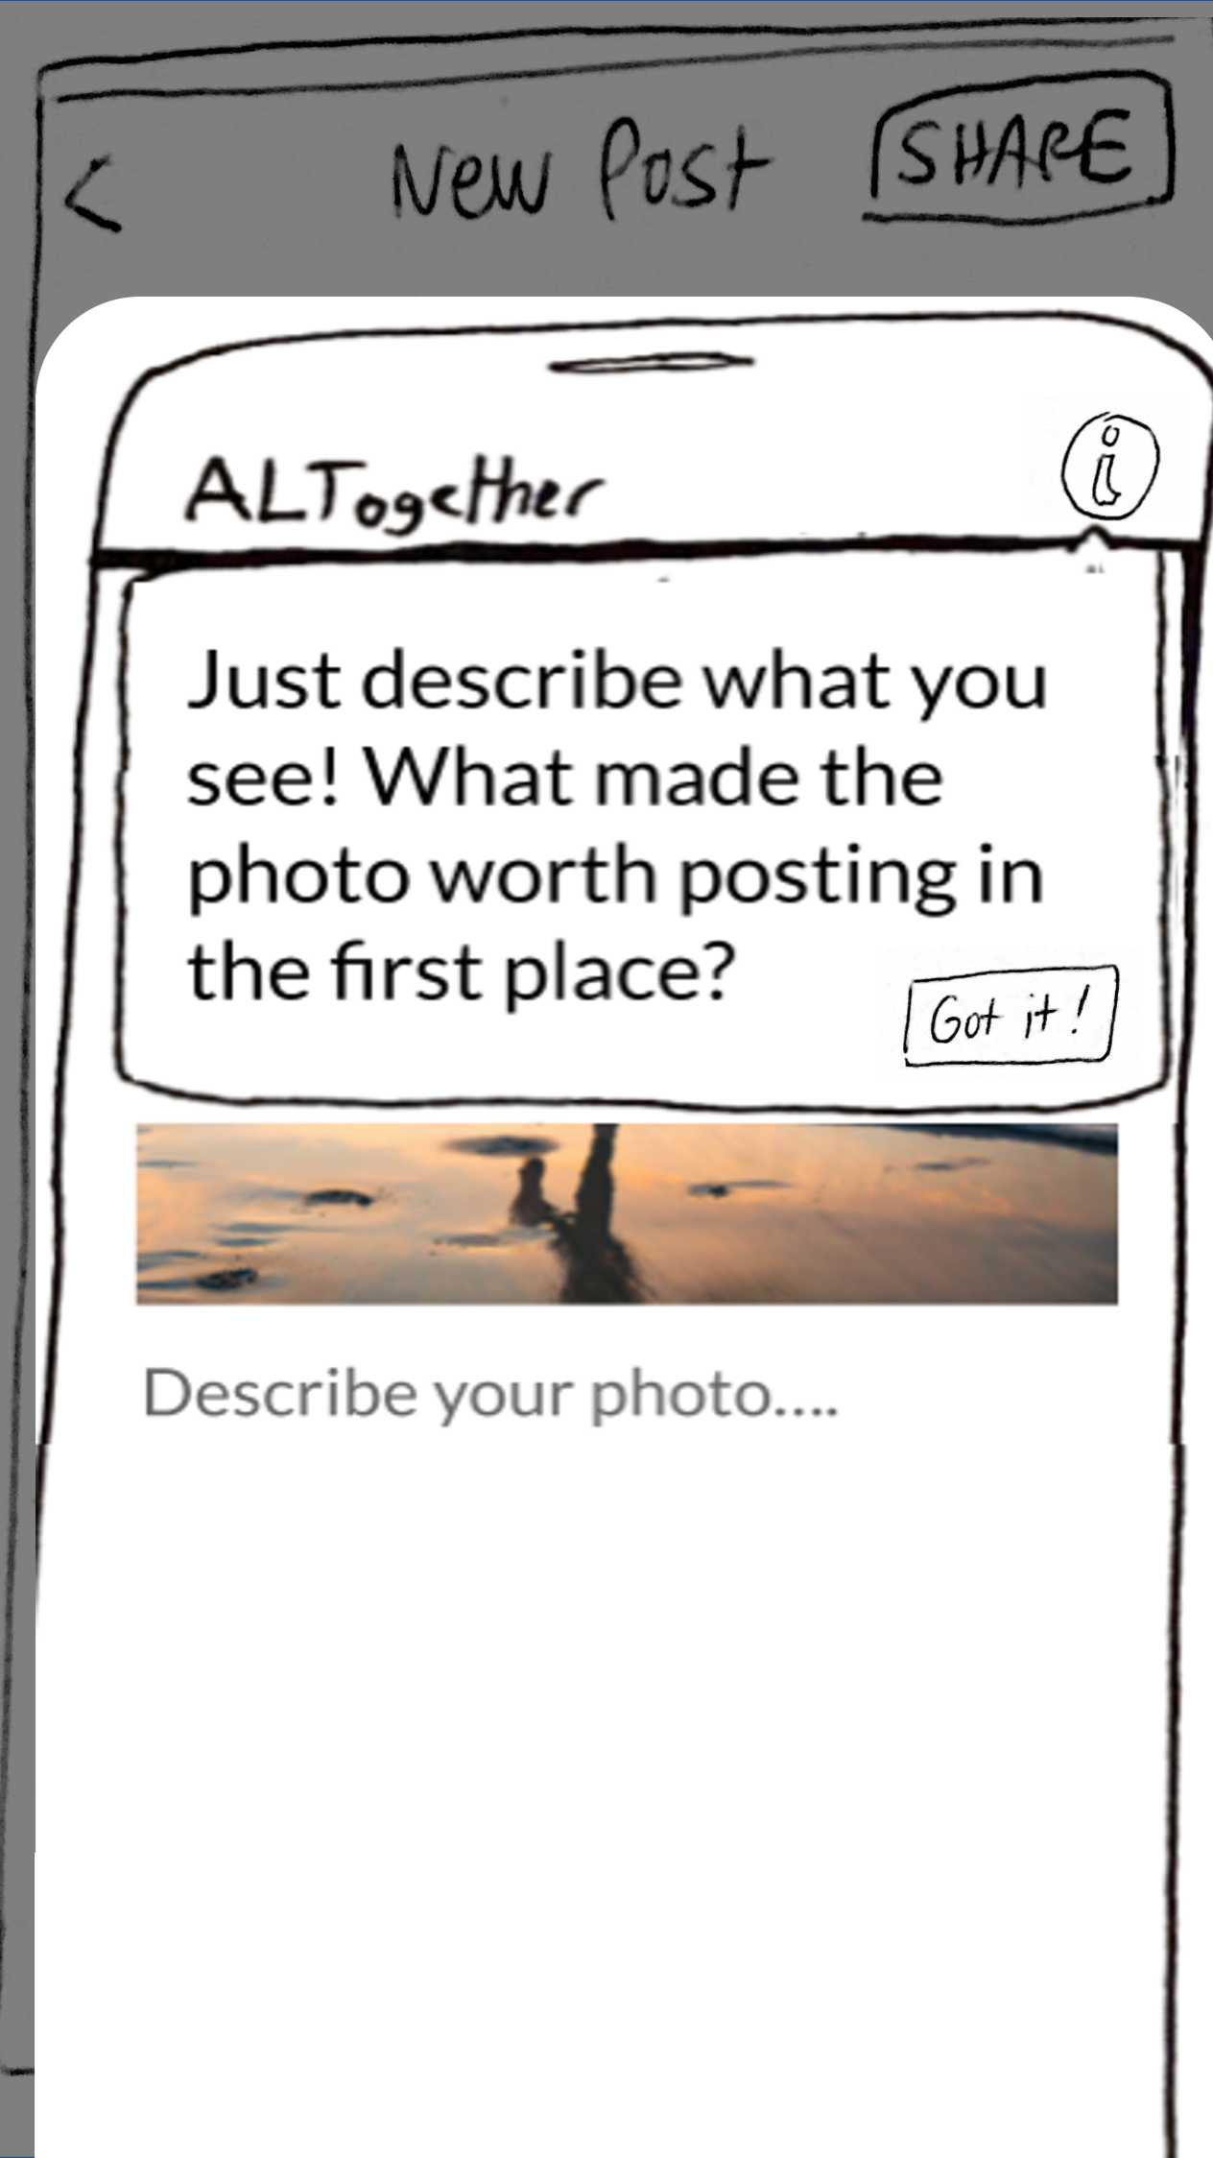
Task 1
Sighted users are reminded to write alt text and can lfindl where to write it in the first place

Slide 11
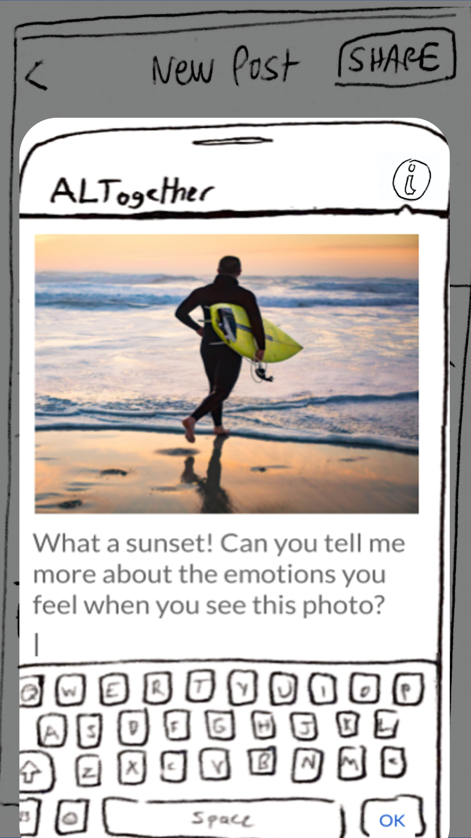
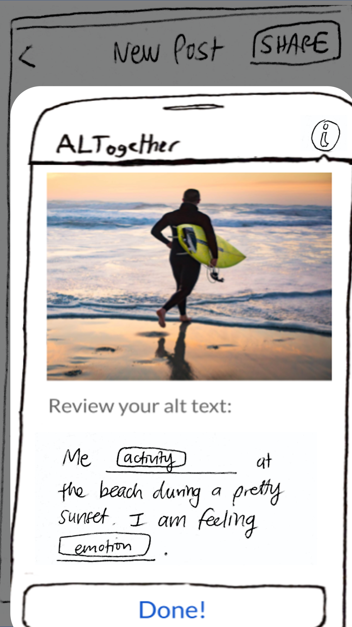
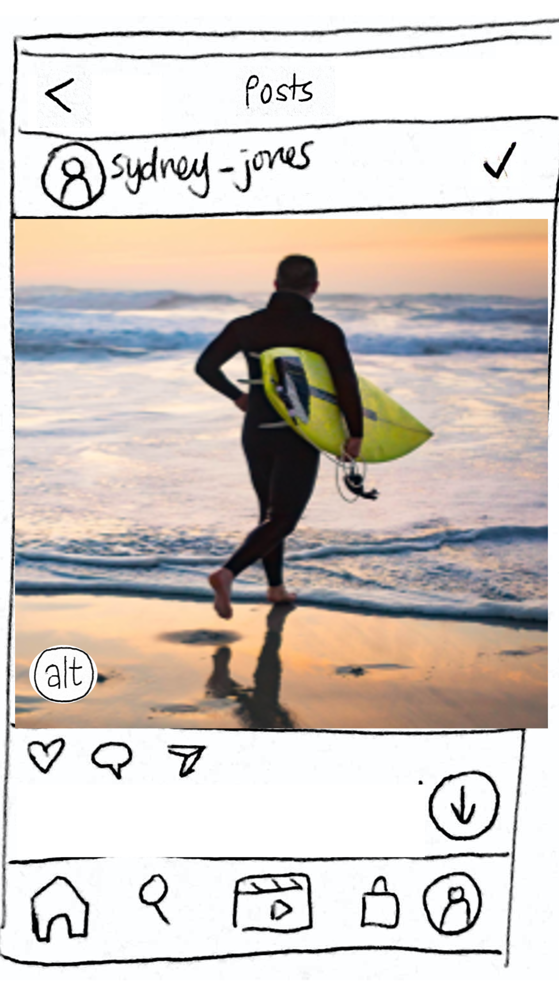
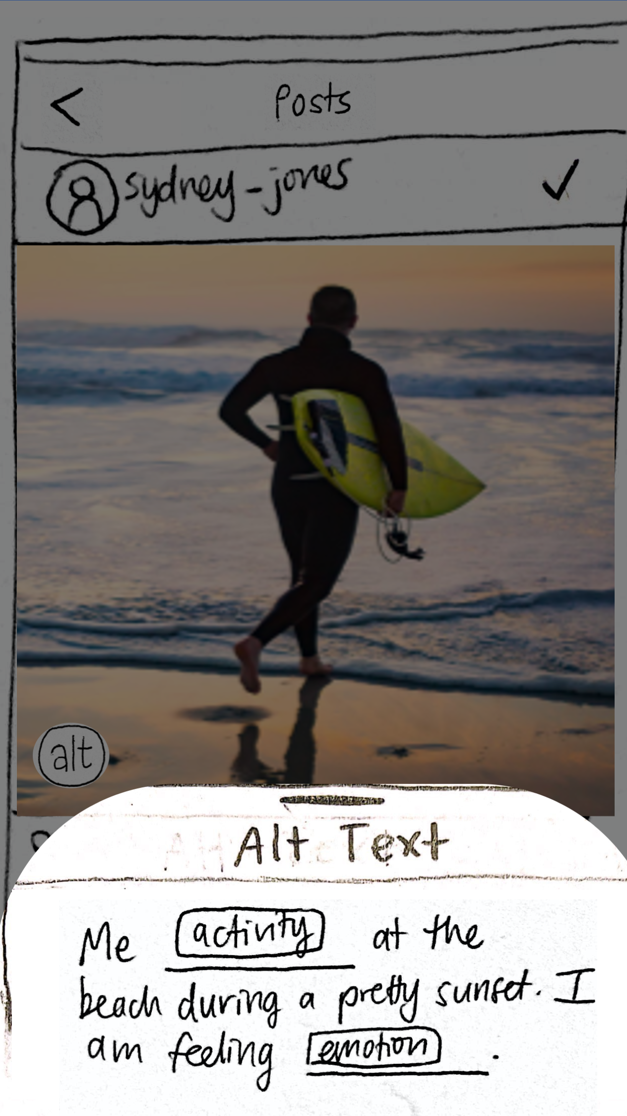
Task 2
Sighted users lmodifyl auto-generated alt text suggestions to add personalized lcontextl to their images
Notes:
[talk about how we followed the questions strategy from the research article that Gloria suggested!]

Slide 12
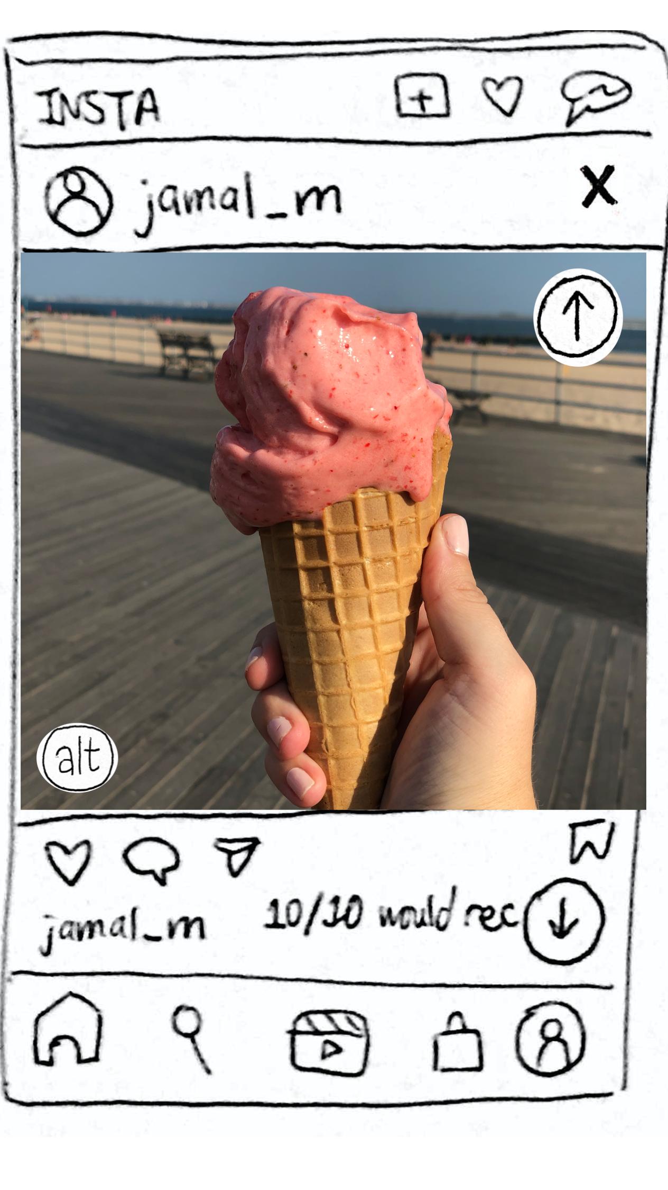
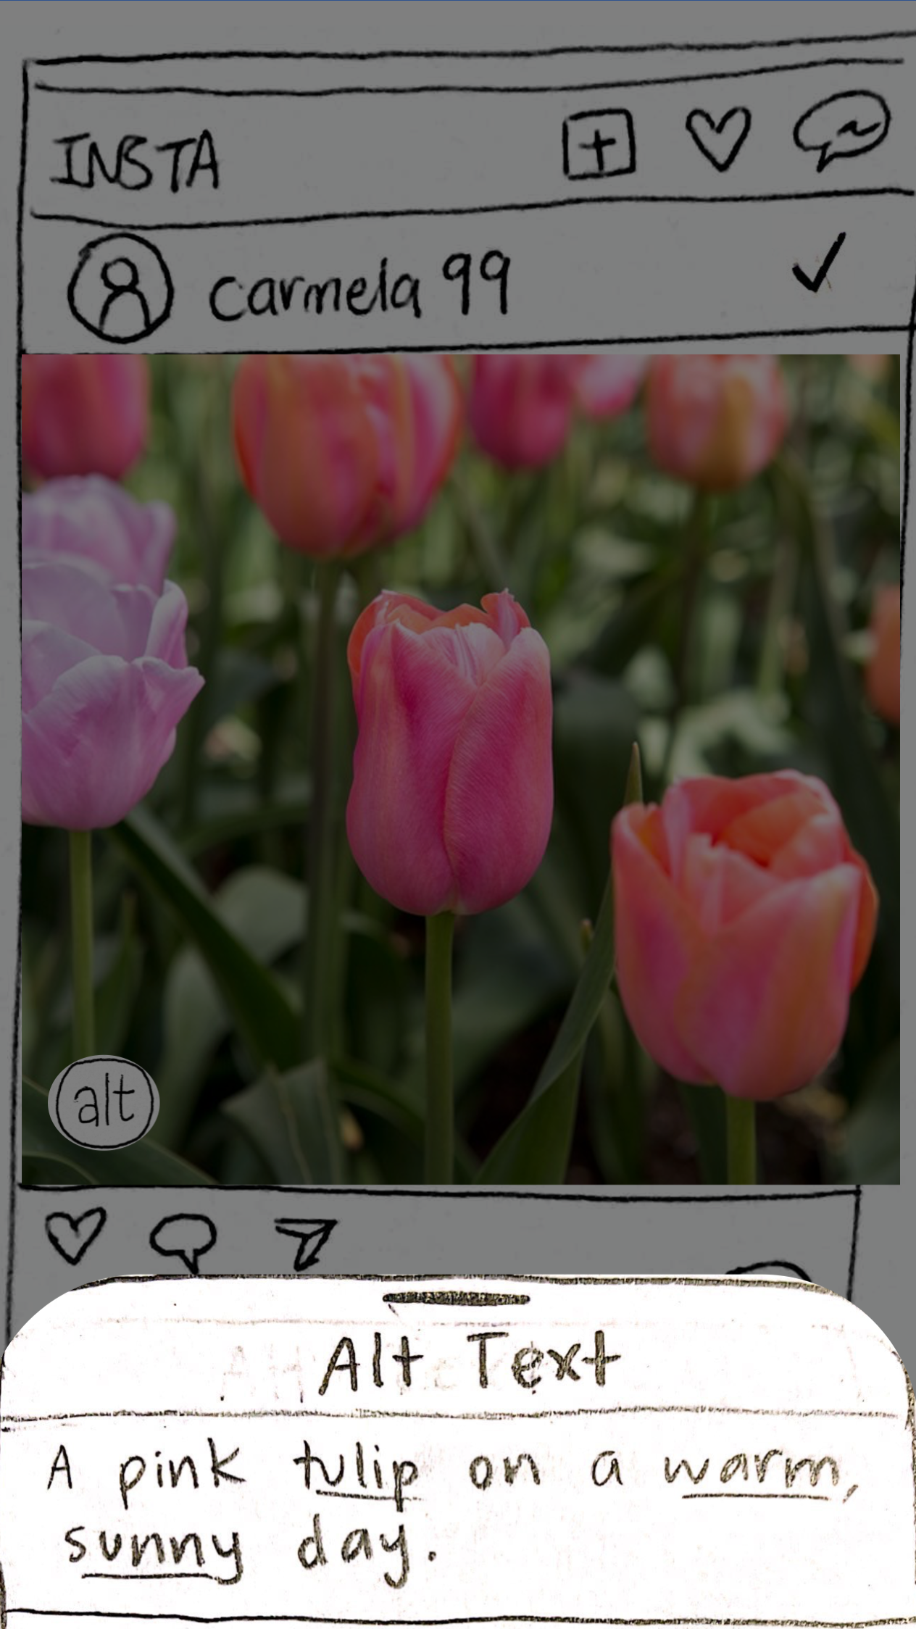
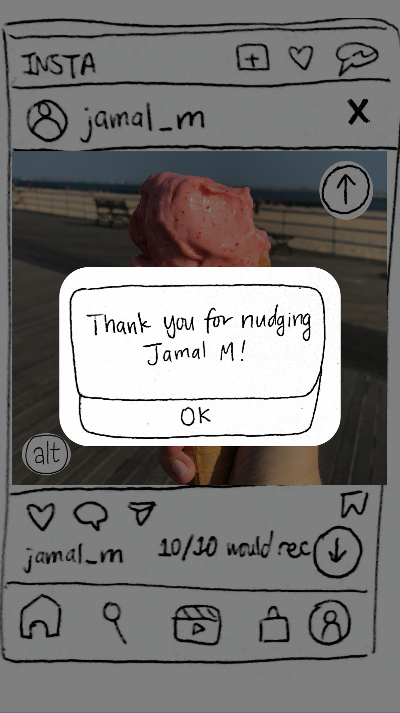
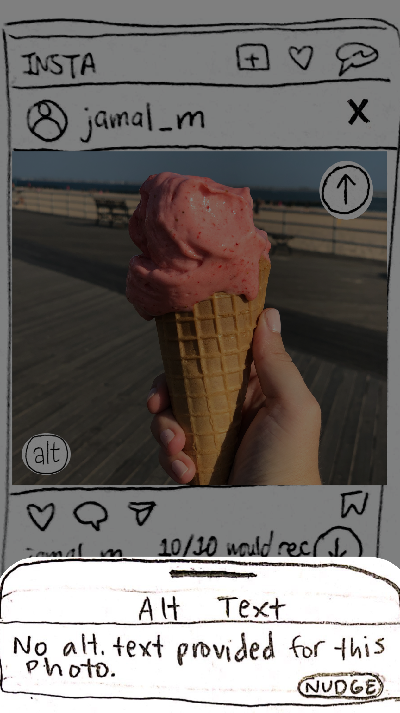
Task 3
Sighted users lidentifyl which photos lack alt text and lencouragel friends to add their own personalized alt texts
Notes:
JW

Slide 13
Revised Interface Design
Notes:
Sydney

Slide 14
Major Design Changes
Notes:
Sydney

Slide 15
Change 1: Auto-generate an editable template
Before
After
Notes:
Considered chrome extensions, a separate app, general extension that worked across all social media
If we really wanted to innovate new interactions that were unique and engaging, we would have to tailor it to a specific user flow
So getting into the nitty gritty details would allow us to make interactions that were natural, integrated, and not too heavy of a “lift” for the user
It also plays into our value of normalization - visually imapired interviewees wanted to use the same technologies everyone else does, and most people don’t want to download a new app or change the way they interact with their platforms
Few ways this would work, ideally, we could partner with instagram
Extension that users could download that would make a few changes to their instagram app
We wanted to make sure it worked for mobile since most social media is accessed mobilly, and we chose instagram because the primary way of interfacing with this platform is through pictures
We thought it would be a perfect candidate for our idea.
From Jung-Won’s pros and cons list!
Rationale for Mobile Extension > Camera Extension:
Integrating the extension directly into Instagram reduces the need to switch back and forth between different apps in order to write alt text for images
Auto-generated alt text captions are often very inconsistent and unreliable
We chose Instagram over other social media platforms because it is purely image-based, so it is the least accessible without alt text.
People are less likely to take pictures with a separate camera app. Instead, people are more likely to write an alt text for an image they have already taken at the time of uploading.

Slide 16
Change 1: Auto-generate an editable template
Before
We had empty text boxes where the user could compose their alt text completely from scratch. Following a question-answer model, the user would generate full sentences in response to different prompts, and their individual answers would be consolidated into a complete alt text. However, many users confused these prompts with suggestions for writing regular captions on their images, and they thought examples of well-written alt text were more helpful than complex explanations or tips. Last, many users felt it was too much work to type out full sentences for multiple prompts, as it made them less likely to take the time to write out quality responses.
After
We revised our guided alt text process to begin by auto-generating a suggested alt text and having the user edit it with more detailed, more accurate context. Suggestions appear in small bubbles where the user can click and write replacements for incomplete or incorrect suggestions. This way, users can still correct and personalize their alt texts without having to start completely from scratch, reducing the amount of time and effort they would need to invest into writing a quality description. Additionally, starting with an auto-generated template gives users a clearer idea of what sorts of details are included in a quality alt text and how long they should typically be.
Notes:
Considered chrome extensions, a separate app, general extension that worked across all social media
If we really wanted to innovate new interactions that were unique and engaging, we would have to tailor it to a specific user flow
So getting into the nitty gritty details would allow us to make interactions that were natural, integrated, and not too heavy of a “lift” for the user
It also plays into our value of normalization - visually imapired interviewees wanted to use the same technologies everyone else does, and most people don’t want to download a new app or change the way they interact with their platforms
Few ways this would work, ideally, we could partner with instagram
Extension that users could download that would make a few changes to their instagram app
We wanted to make sure it worked for mobile since most social media is accessed mobilly, and we chose instagram because the primary way of interfacing with this platform is through pictures
We thought it would be a perfect candidate for our idea.
From Jung-Won’s pros and cons list!
Rationale for Mobile Extension > Camera Extension:
Integrating the extension directly into Instagram reduces the need to switch back and forth between different apps in order to write alt text for images
Auto-generated alt text captions are often very inconsistent and unreliable
We chose Instagram over other social media platforms because it is purely image-based, so it is the least accessible without alt text.
People are less likely to take pictures with a separate camera app. Instead, people are more likely to write an alt text for an image they have already taken at the time of uploading.

Slide 17
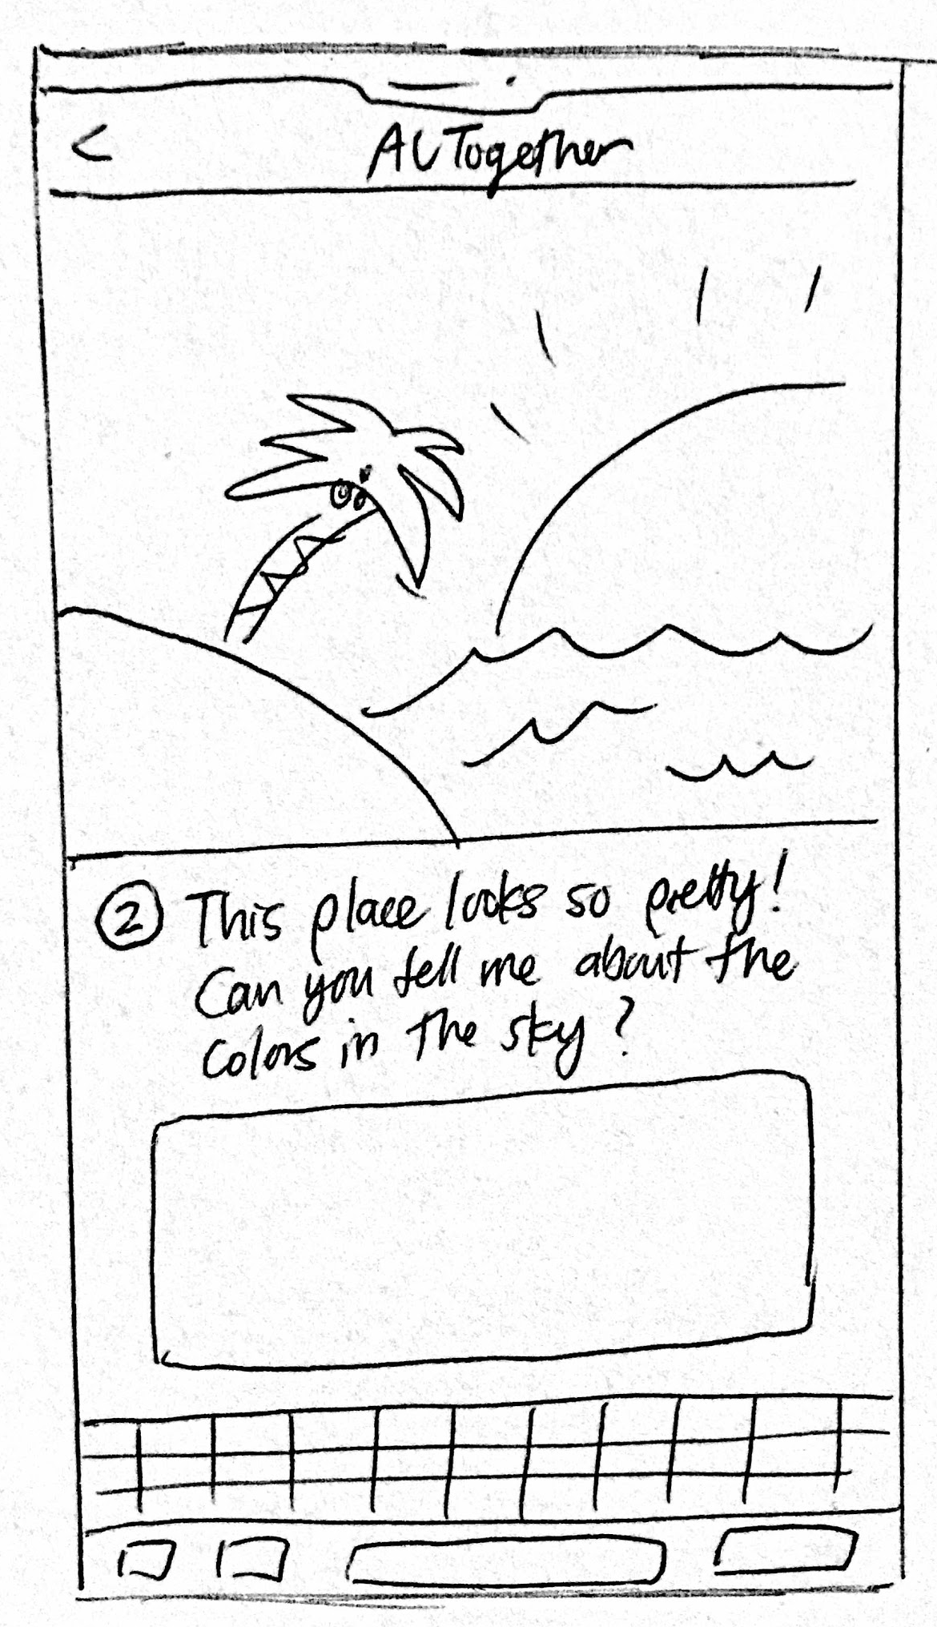
Change 2: Consolidate and embed alt text prompts
Before
After
Notes:
Considered chrome extensions, a separate app, general extension that worked across all social media
If we really wanted to innovate new interactions that were unique and engaging, we would have to tailor it to a specific user flow
So getting into the nitty gritty details would allow us to make interactions that were natural, integrated, and not too heavy of a “lift” for the user
It also plays into our value of normalization - visually imapired interviewees wanted to use the same technologies everyone else does, and most people don’t want to download a new app or change the way they interact with their platforms
Few ways this would work, ideally, we could partner with instagram
Extension that users could download that would make a few changes to their instagram app
We wanted to make sure it worked for mobile since most social media is accessed mobilly, and we chose instagram because the primary way of interfacing with this platform is through pictures
We thought it would be a perfect candidate for our idea.
From Jung-Won’s pros and cons list!
Rationale for Mobile Extension > Camera Extension:
Integrating the extension directly into Instagram reduces the need to switch back and forth between different apps in order to write alt text for images
Auto-generated alt text captions are often very inconsistent and unreliable
We chose Instagram over other social media platforms because it is purely image-based, so it is the least accessible without alt text.
People are less likely to take pictures with a separate camera app. Instead, people are more likely to write an alt text for an image they have already taken at the time of uploading.

Slide 18
Change 2: Consolidate and embed alt text prompts
Before
We had multiple pages each containing a different alt text prompt (e.g. “That looks so tasty! Can you tell me what flavor it is?”), and the user would submit their response before moving on to the next prompt. We found that users appreciated these scaffolded prompts, as they liked how it broke down the unfamiliar process of writing alt text into more manageable chunks. However, in all 3 of our interviews, the user clicked through these prompts too quickly, consequently missing a few key details about what the prompt was asking. Many users also found it overwhelming to answer prompt after prompt since it posed too much text to read all at once.
After
We consolidated the entire alt text writing process into a single screen, so that users must more intentionally interact with the prompts rather than mindlessly click through them. In order to maintain the balance between guiding the user through prompts and not overwhelming them with much text, we kept the structure of scaffolded prompts but decided to embed the prompts within the process of editing. Therefore, users would only encounter “mini-prompts” for the suggestion bubbles that they choose to edit.
Notes:
Considered chrome extensions, a separate app, general extension that worked across all social media
If we really wanted to innovate new interactions that were unique and engaging, we would have to tailor it to a specific user flow
So getting into the nitty gritty details would allow us to make interactions that were natural, integrated, and not too heavy of a “lift” for the user
It also plays into our value of normalization - visually imapired interviewees wanted to use the same technologies everyone else does, and most people don’t want to download a new app or change the way they interact with their platforms
Few ways this would work, ideally, we could partner with instagram
Extension that users could download that would make a few changes to their instagram app
We wanted to make sure it worked for mobile since most social media is accessed mobilly, and we chose instagram because the primary way of interfacing with this platform is through pictures
We thought it would be a perfect candidate for our idea.
From Jung-Won’s pros and cons list!
Rationale for Mobile Extension > Camera Extension:
Integrating the extension directly into Instagram reduces the need to switch back and forth between different apps in order to write alt text for images
Auto-generated alt text captions are often very inconsistent and unreliable
We chose Instagram over other social media platforms because it is purely image-based, so it is the least accessible without alt text.
People are less likely to take pictures with a separate camera app. Instead, people are more likely to write an alt text for an image they have already taken at the time of uploading.

Slide 19
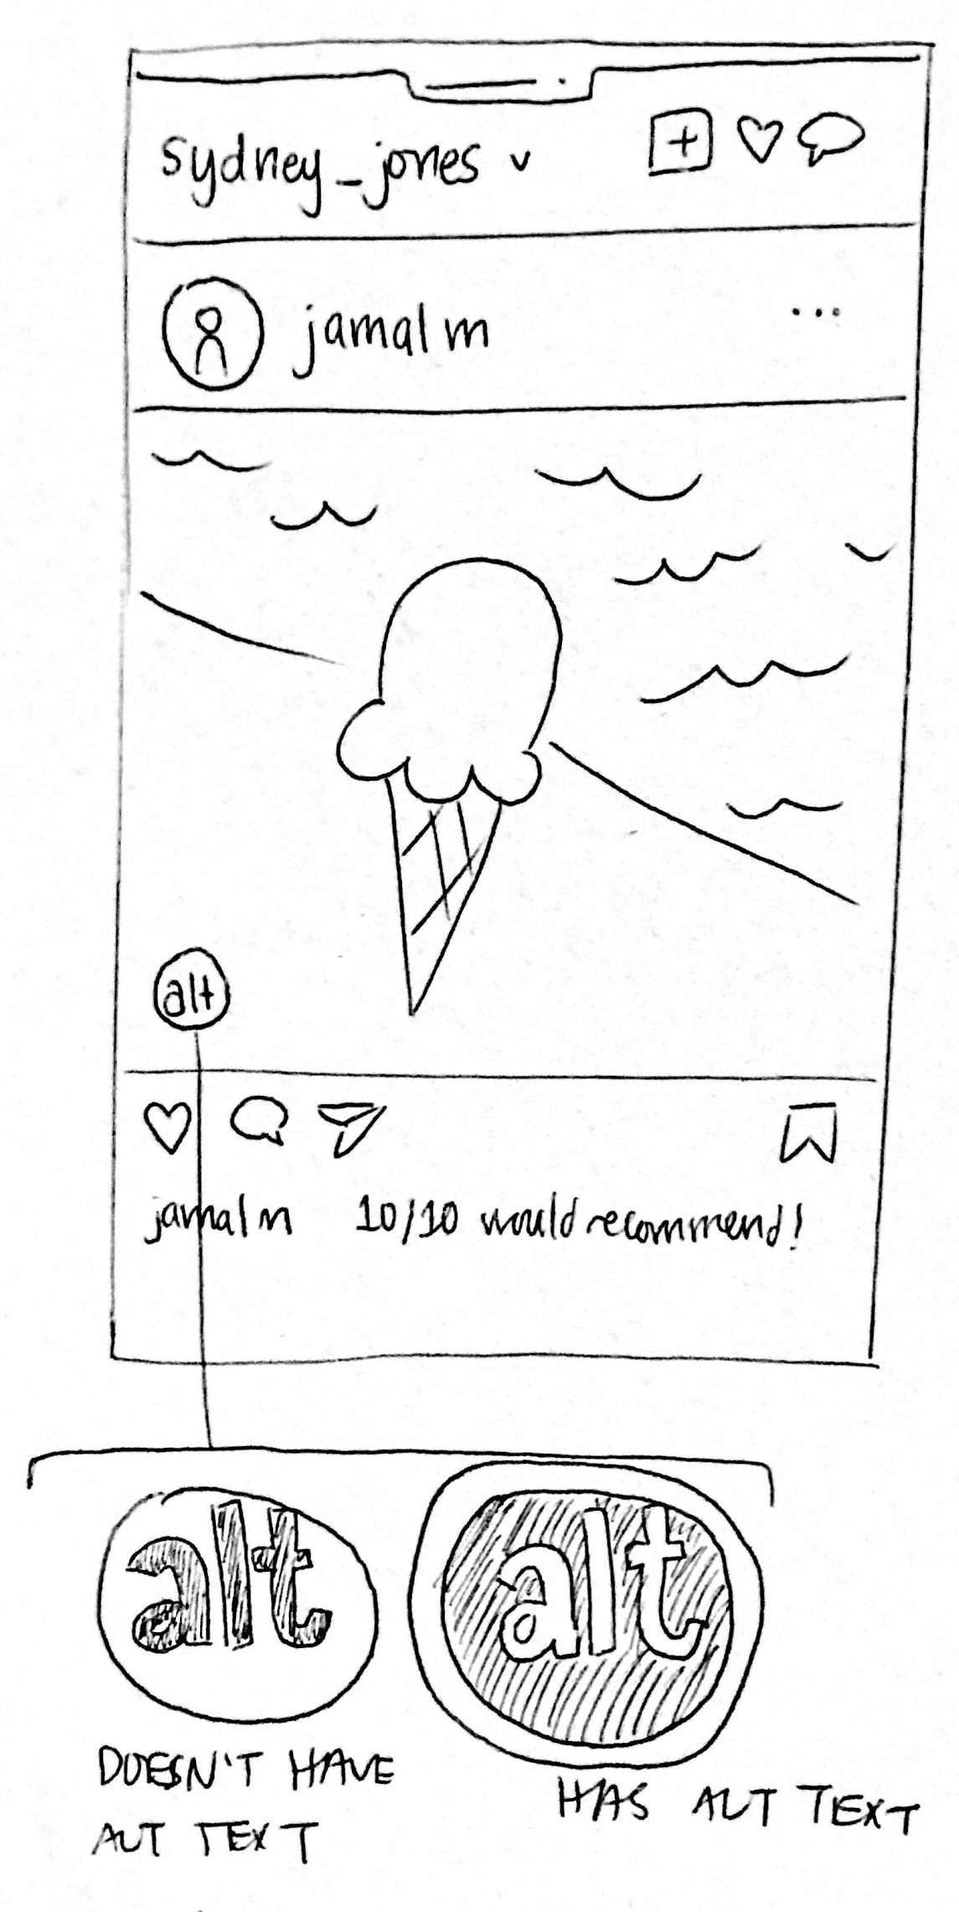
Change 3: Merge alt text indicators into one icon
Before
After
Notes:
Considered chrome extensions, a separate app, general extension that worked across all social media
If we really wanted to innovate new interactions that were unique and engaging, we would have to tailor it to a specific user flow
So getting into the nitty gritty details would allow us to make interactions that were natural, integrated, and not too heavy of a “lift” for the user
It also plays into our value of normalization - visually imapired interviewees wanted to use the same technologies everyone else does, and most people don’t want to download a new app or change the way they interact with their platforms
Few ways this would work, ideally, we could partner with instagram
Extension that users could download that would make a few changes to their instagram app
We wanted to make sure it worked for mobile since most social media is accessed mobilly, and we chose instagram because the primary way of interfacing with this platform is through pictures
We thought it would be a perfect candidate for our idea.
From Jung-Won’s pros and cons list!
Rationale for Mobile Extension > Camera Extension:
Integrating the extension directly into Instagram reduces the need to switch back and forth between different apps in order to write alt text for images
Auto-generated alt text captions are often very inconsistent and unreliable
We chose Instagram over other social media platforms because it is purely image-based, so it is the least accessible without alt text.
People are less likely to take pictures with a separate camera app. Instead, people are more likely to write an alt text for an image they have already taken at the time of uploading.

Slide 20
Change 3: Merge alt text indicators into one icon
Before
We had two separate alt text identifiers: (1) a small “✓/✖️” icon at the top-right corner of each post indicating whether an image has alt text, and (2) an alt text icon at the bottom-left corner where the user could click and see the provided alt text or “nudge” the original poster to write one. We decided to split these icons into two because we wanted a way for users to quickly identify if an image had alt text without having to first click the alt text icon to see it. However, many users were confused about what the “✓/✖️” meant, as they thought it might mean that the poster was a verified celebrity or that you had liked the image. They didn’t realize how it related to alt text at all.
After
We combined these two symbols into a single alt text icon. Because users had found the “✓/✖️” and the original alt text icon so unrelated, we applied Gestalt principles to group these elements together. Rather than have a completely separate symbol on the opposite side of the post, this new alt text icon merges both functions and uses a colored outline to indicate if the image includes alt text. This way, users can still quickly identify which images are accessible upon first glance. Additionally, the colored outline recalls the familiar action of tapping on “IG stories,” suggesting that the user can click on the icon for additional interactions like nudging.
Notes:
Considered chrome extensions, a separate app, general extension that worked across all social media
If we really wanted to innovate new interactions that were unique and engaging, we would have to tailor it to a specific user flow
So getting into the nitty gritty details would allow us to make interactions that were natural, integrated, and not too heavy of a “lift” for the user
It also plays into our value of normalization - visually imapired interviewees wanted to use the same technologies everyone else does, and most people don’t want to download a new app or change the way they interact with their platforms
Few ways this would work, ideally, we could partner with instagram
Extension that users could download that would make a few changes to their instagram app
We wanted to make sure it worked for mobile since most social media is accessed mobilly, and we chose instagram because the primary way of interfacing with this platform is through pictures
We thought it would be a perfect candidate for our idea.
From Jung-Won’s pros and cons list!
Rationale for Mobile Extension > Camera Extension:
Integrating the extension directly into Instagram reduces the need to switch back and forth between different apps in order to write alt text for images
Auto-generated alt text captions are often very inconsistent and unreliable
We chose Instagram over other social media platforms because it is purely image-based, so it is the least accessible without alt text.
People are less likely to take pictures with a separate camera app. Instead, people are more likely to write an alt text for an image they have already taken at the time of uploading.

Slide 21
Medium-Fi Prototype Task Flows
Notes:
Sydney

Slide 23
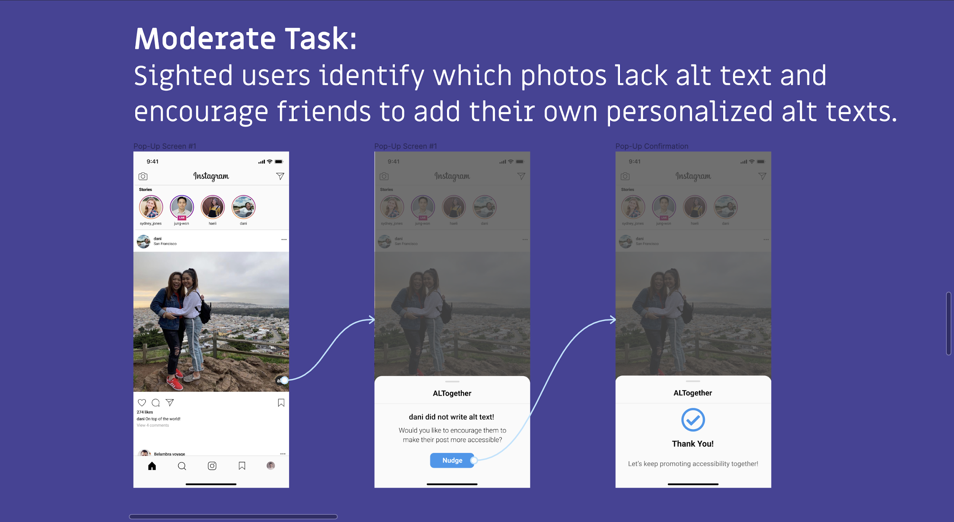

Slide 25
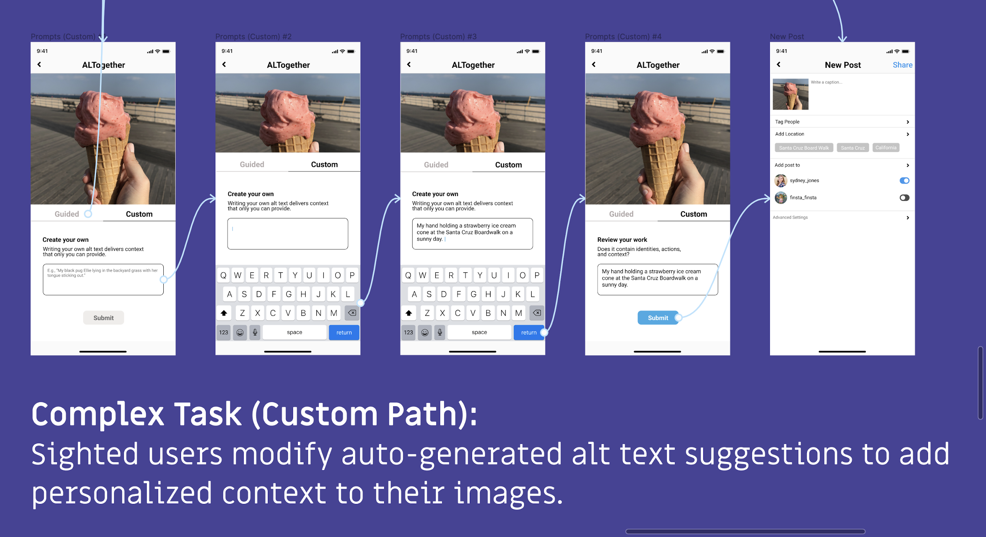

Slide 26
Prototype Overview
Notes:
Sydney

Slide 27
Design/Prototyping Tools
Place your screenshot here
We used Figma to design our prototype
Good
Access to both design and prototype features
Add interaction
Easy to compile a demo of the product
Ability to collaborate
Bad
Tedious process of making many variations of the same page
Hard to keep track of all prototype interactions across screens

Slide 28
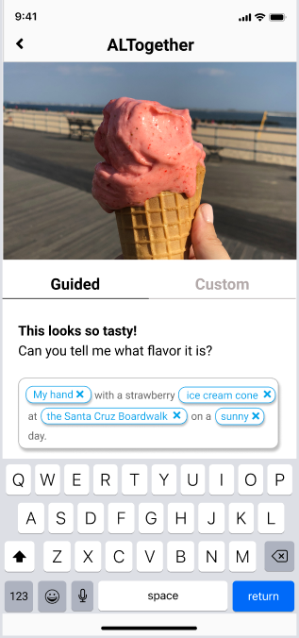
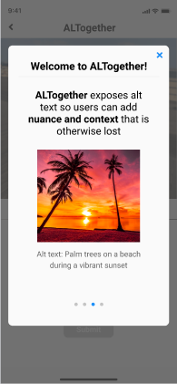
Limitations/Tradeoffs
Place your screenshot here
Our product is intended for Instagram, but we were unable to design paths for every possible interaction on the normal app (e.g. searching the explore page, commenting on post, etc.)
Since our prototype doesn’t allow the user to actually type on a real keyboard, we filled in the input for them (i.e. pre-filling in the “edited” alt text bubbles)
No swiping functionality for the introduction to ALTogether section

Slide 29
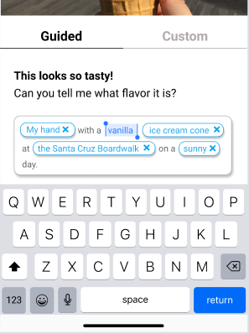
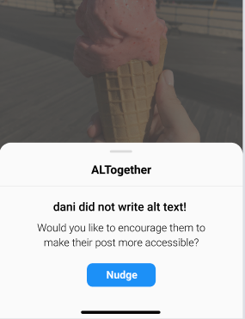
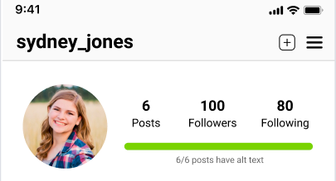
Wizard of Oz Techniques
Place your screenshot here
Prompt Generation
Nudge Feature
Progress Bar
detecting key image features and providing relevant prompts
assume notifications are sent to friend when nudged
having access to Instagram API to detect how many images have alt text

Slide 30
Hard-Coded Features
Place your screenshot here
Feed
Main Instagram feed and personal feed accessed through profile
Images, comments, fake profiles
Image uploading and alt text writing
Predetermined pathway for posting picture with alt text
Which photo from gallery to post; alt text caption; photo filter

Slide 31
Appendix
Notes:
Sydney

Slide 32
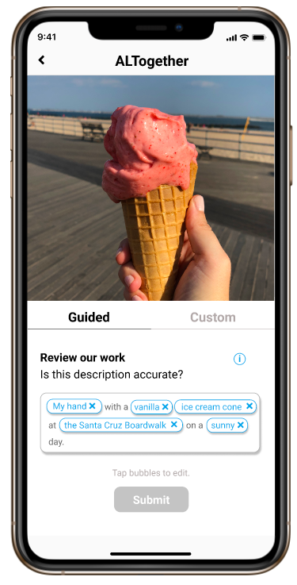
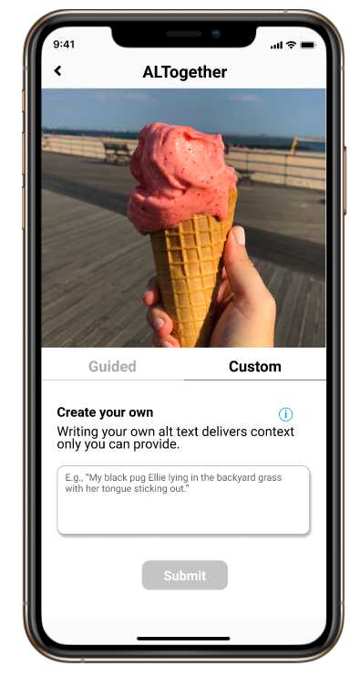
Additional Prototype Screenshots
VS
Guided Prompts
Custom Prompts
Notes:
@Dani add screenshot from Zoom chat
@Jung-Won

Slide 33
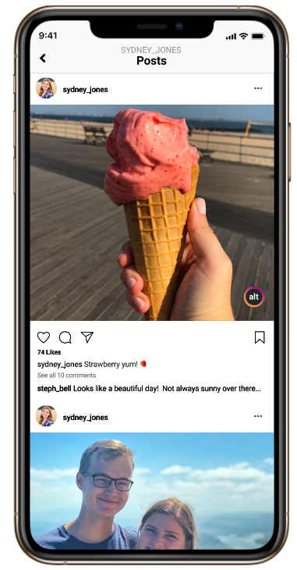
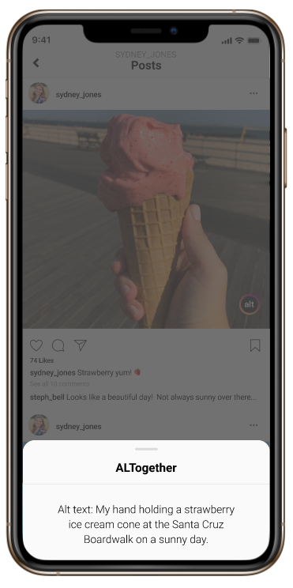
Additional Prototype Screenshots
Checking alt text on your image
Notes:
@Dani add screenshot from Zoom chat
@Jung-Won

Slide 34
Notes:
Sydney

Slide 35
EXTRA GRAPHICS

